Slide 1




BATTERY ENERGY STORAGE SYSTEM
10.06.2025
Senthur Power Services PVT LTD
www.senthurpower.com

Slide 2



SPSPL RESPONSE TO CHANGING MARKETS
Thermal Industries
+
Turnkey Projects, Products und Services for:
Combined Cycle Gas Turbine Plants (CCGT)
Integrated Gasification Combined Cycle (IGCC)
Coal-fired Boilers
Waste-to-Energy Boilers
Industrial Boilers
Expanding our Portfolio
Decarbonisation of Energy Industry
and Industrial Sectors
Turnkey Projects, Products and Services for:
Hydrogen Gas Turbines
Power-to-X (Heat Pumps, Green Hydrogen)
Energy Storage
Solid Oxide Fuel Cells
CO₂ capture/utilization
Digital Solutions
www.senthurpower.com

Slide 3











BATTERY ENERGY STORAGE SYSTEM
Electricity
ENERGY EFFICIENCY
www.senthurpower.com

Slide 4





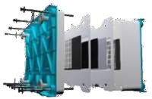





ENERGY OFFERING FLEXIBLE TECHNOLOGIES, DELIVERING SOLUTIONS
Hydrogen
1
H
Hydrogen
1.00794
H
Lithium Ion
(<6 hours)
Flow (4-12
hours)
Renewable Hydrogen (>24 hours)
Commercial &
Industrial Use
Renewable Energy Integration
Grid
Services
Microgrids
Fuel cell + Solar Storage
Hybrid Power Plants
Gas Turbines
~ 500kW – 3MW
~ > 5MW
~ > 5MW
~ > 500kW
~ > 20MW
www.senthurpower.com

Slide 5










BESS FUNCTION DIAGRAM
HVAC: Heating Ventilation and Air Conditioning
UPS: Uninterruptible Power Supply
FSS: Fire Suppression System
BMS: Battery Management System
BCP: Battery Control Panel
EMS: Energy management system
SCADA: Supervisory Control And Data Acquisition
Typical BESS Container
DC
System Operation
EMS & SCADA System
UPS
Reserve
HVAC
FSS
Inverter
DC – AC conversion
Transformer
LV – MV conversion
Grid Connection
BMS
Battery
BCP Rack
www.senthurpower.com

Slide 6



BESS APPLICATIONS
BESS
BESS
BESS
Residential
Generation
Transmission
Distribution
Commercial and Industries
Microgrid
Front of The Meter Applications
Electricity Meter
Behind The Meter Applications
www.senthurpower.com

Slide 7








Frequency Regulation & Ancillary Services
Critical Power, Generation Enhancement / Deferral
Renewable Integration
Energy Management, Peak Capacity
BESS provides:
Frequency regulation
Black start
Spinning and non-
BESS provides
Backup power
The defer need for
other peaking supply resource
Transmission
congestion relief
Transmission upgrade
deferral
Energy Arbitrage
Firming capacity
BESS is dispatched
To smooth out the
output of renewable energy assets
To provide more
predictable production
Firming capacity
BESS is dispatched
To reduce peak load
To provide time shifting
To provide electric supply capacity
To provide power quality
or demand charge management
spinning reserve Reactive Power and Voltage control
Power Quality
Load
Ramping renewables
•
following/
up for
Duration: 0.5h – 1h
Duration: 1h – 2h
Duration: 2h – 4h
Duration: ~4
www.senthurpower.com

Slide 8




BESS INTEGRATED WITH GRID SERVICES
Standard Situation
Frequency Regulation
Frequency Deviation
High demand or supply.
Costly TSO or DSO assets installationto treat occasionallypeak demand.
Distribution circuit experiencing load growth.
Grid outages.
Voltage unbalance events.
Non-critical Frequency range
Charge
Charge
Nominal Frequency
Discharge
Frequency Deviation
BESS Applications
Frequency regulations
Voltage control and Power quality
Black start
Spinning reserve
Without power quality
With power quality
BESS Advantages
Reduce the cost for backup fossil fuel-based generation ancillary services.
Fast response under load variations.
Providing black start services for conventional generating plant.
Save the operational costs in powering the grid.
Reduce the cost to provide frequency regulation and spinning
reserve services.
Balance between supply and demand.
Protection against voltage fluctuations and defects on facility
components.
Mains voltage / Mains current
www.senthurpower.com

Slide 9

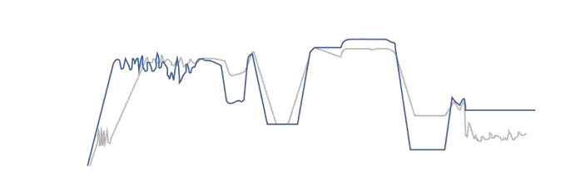









BESS INTEGRATED WITH HYBRID POWER PLANTS
Flexible operation line Standard operation line
Standard Situation
Power
Frequency response PFR + SFR
Spinning reserve
Limiteduse of diesel generators or gas engine to black start capabilities.
Slow power plant response to grid fluctuations.
Increase or decrease of the demand needs below the minimum run threshold of the power plant.
Load changes.
Fast start
Islanding,
off-grid
Fast ramp-up and ramp-down support
BESS Applications
Minimum environmental load
Black start and support of grid restorage.
Spinning reserve for peak power.
Stabilization of ramp loads in case of imbalances in the grid.
Islanding and off-grid services (industrial power plants).
Black start
Time
BESS Advantages
Offering large number of application opportunies in addition to black start capabilities.
Fast response (<1 sec) of power supply to the grid until the gas
turbine take over.
Stablizing of gas and steam turbines during grid outages.
Reduce the stress on the gas and steam turbine.
Reduce CO2 emissions.
Reduce the maintenance and fuel costs.
Offering regulation capacities for the power plant.
Gas Turbine
Generator
Transformer
Grid
Inverter
www.senthurpower.com
BESS

Slide 10
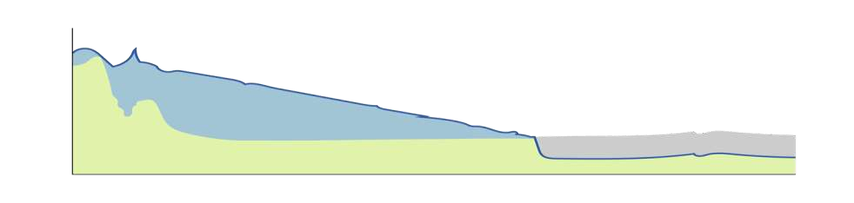
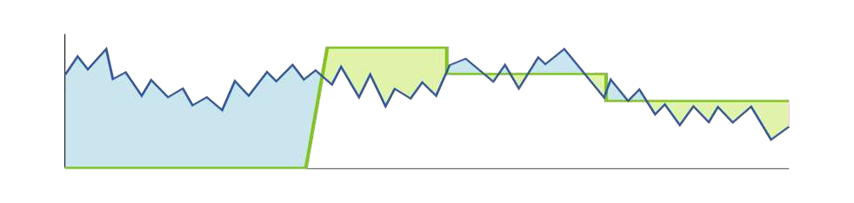
BESS INTEGRATED WITH RENEWABLE ENERGY
Standard Situation
Power to grid PV to grid
BESS to grid PV to BESS
Renewable energy fluctuations.
The use of high-cost generators ( e.g. gas plants)
High generation in off-peak time
Limited RE generation during peak time.
Power
Ramp rate control
State of charge control
BESS Applications
Ramp rate control.
More predictable production.
Firming capacity.
Time
BESS Advantages
Increase self consumption.
Smoothing PV power fluctuations.
Meet the demand during peak periods or other high-risk periods.
Ensure adequate peaking generation capacity.
Shifting renewable energy generation for peak demand coverage.
Reduce the use of the high cost of generators.
Optimize the energy costs.
Night
Day
Power
Discharge
Charge
Charge
Discharge
Wind Power
Wind Power + BESS power
Time

Slide 11
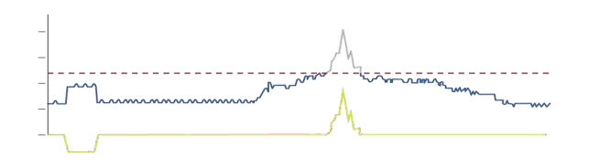
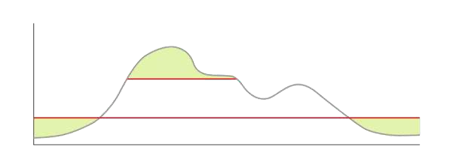
BESS IN COMMERCIAL AND INDUSTRIAL USE
Daily net load profile with energy storage
Standard Situation
Battery
Net Load
High demand in peak times.
Low demand in off-peak times.
High electricity prices.
Risk of critical load: power supply interruptions.
20
15
10
Peak clipped at 12
MW
5
0
-5
BESS Applications
Charging
Discharging
Power backup.
Energy Arbitrage.
Load leveling.
Peak shaving.
Demand response.
Time
BESS Advantages
Power
Original load
Taking advantage of electricity prices.
Balancing energy demand and supply.
Protection from power quality and power supply interruptions by filtering out imperfections in grid power.
Shifting the peak demand by charging during off-peak
times and discharging during the peak times.
Reduction of peak demand and reduction in electricity bill.
Demand shift
Discharging
Smoothed load
Charging
Time
www.senthurpower.com

Slide 12





PEPPER MOTION`S VALUE PROPOSITION
System Integration
Cost Effective
Strong global supply chain partners and scale delivering cost effective solutions
Optimal System design
Supply of components for long term performance
Integration of Tier1 battery and inverter
manufacturers
Financing
Our balance sheet and low cost of capital allows variety of financing to meet customer needs
Long-Term Service
Performance guarantee
Remote monitoring
Operation support
Spare part management
EPC
Ability to execute both union and non- union EPC projects using in-house capabilities and partners
www.senthurpower.com

Slide 13
PEPPER MOTION`S PERFORMANCE GUARANTEES
Energy Capacity Guarantee:
The Energy Capacity Guarantee gives maximum acceptable reduction in system energy capacity as a function of time and as a function of system usage.
Availability Guarantee:
Energy available for charge and discharge as a percentage of time.
Round Trip Efficiency (RTE):
RTE is defined as the ratio between the energy charged and the energy discharged from the BESS. It is generally measured at the point of interconnection.
Performance guarantees are dependent on final selection of battery technology, power conversion systems, and SCADA systems.
www.senthurpower.com

Slide 14


BESS KEY TAKE-AWAYS
Providing
Optimal and customized system design
Project feasibility studies
Cost-effective and agnostic solutions
Proven partnerships with suppliers
Turnkey solutions
Long-term service agreement
Performance guarantees
Enabling
Grid control
Decentralization
Integration of renewables
Effective and high-quality project execution
www.senthurpower.com

Slide 15
SENTHUR POWER SERVICES PVT LIMITED

